Slide 1
TABLEAU CAPSTONE PROJECT
TOP INDIAN COLLEGES OF IIT IIM AIIMS
By - SHRUTIKA GARDAS
BE(CSE)

Slide 2
Executive Summary
The Data consists of Top Indian Colleges of IIT IIM AIIMS, College_Name, State,Stream, UG_fee, PG_fee, Rating, Academic, Accommodation, Faculty, Infrastructure, Placement, Social_Life .
Data Set is having 6269 rows and 12 columns.
The Project is made by Using Offset Function,Parameters,Conditional Formatting and Filters.
By using above Row Data and applying some Data Analysis functions we get a clear view of finalized data

Slide 3
Analysis Based On Parameters
Stream Wise Placement of College’s
State Wise Placement.
Top Rating Colleges of IIT,IIM and AIIMS.
College Faculty and Academic Rating.
Comparison of Social Life vs Academic life.

Slide 4
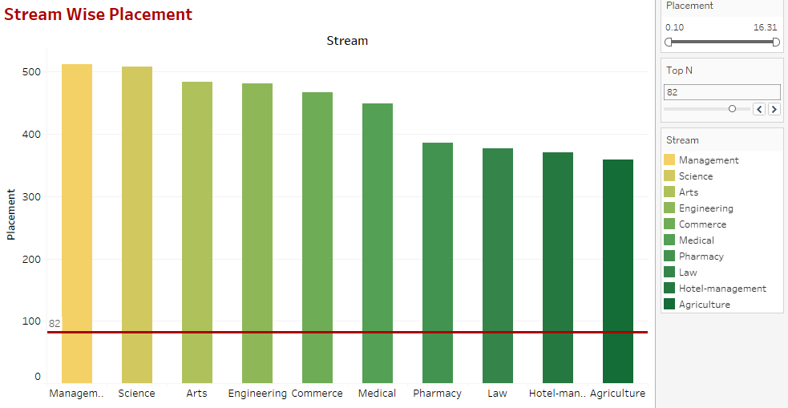
Stream Wise Placement of Colleges

Slide 5
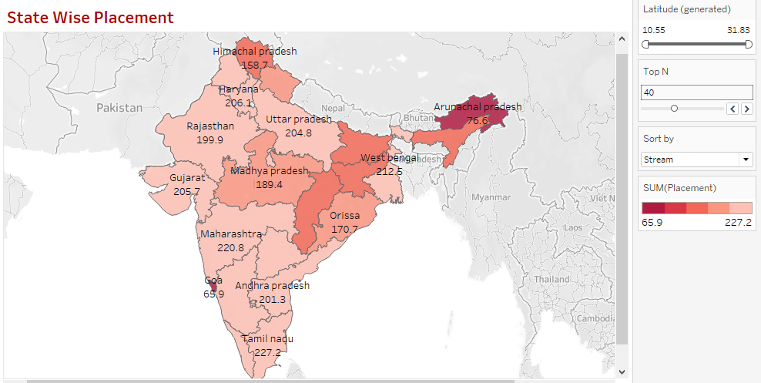
State Wise Placement

Slide 6
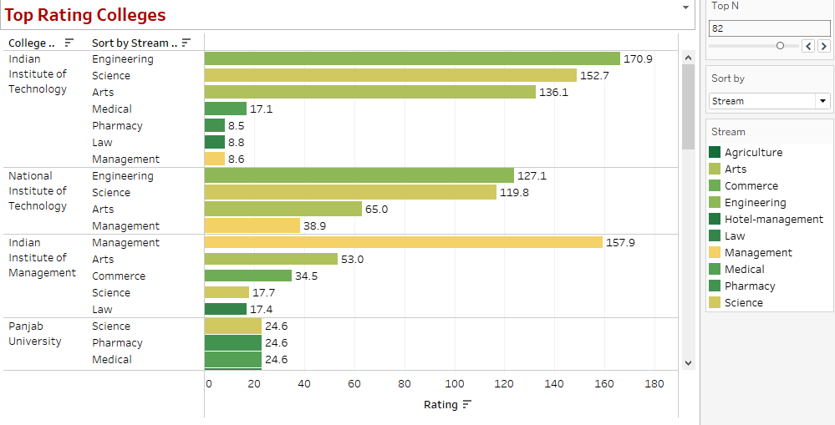
Top Rating Colleges In India

Slide 7
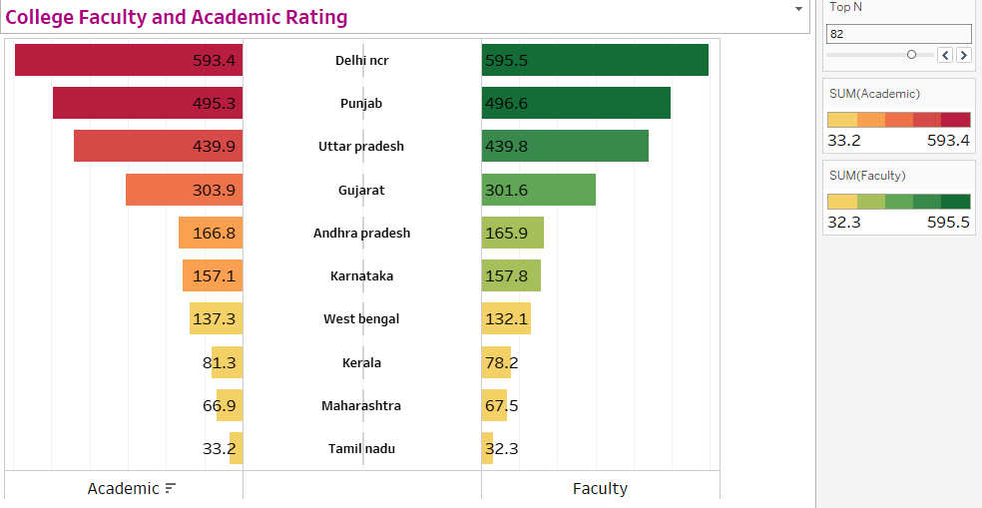
College Faculty and Academic Rating

Slide 8
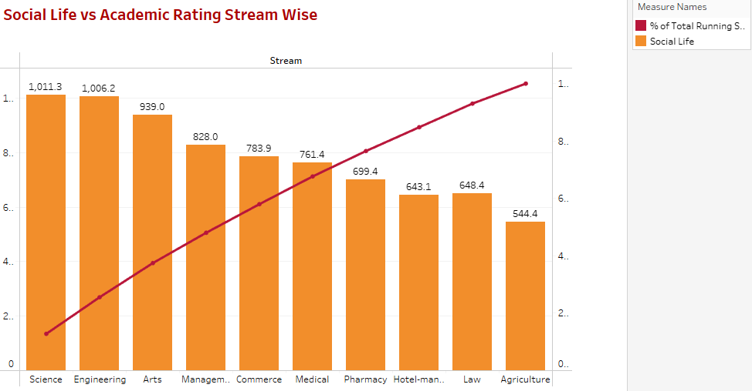
Comparison of Social Life vs Academic life

Slide 9
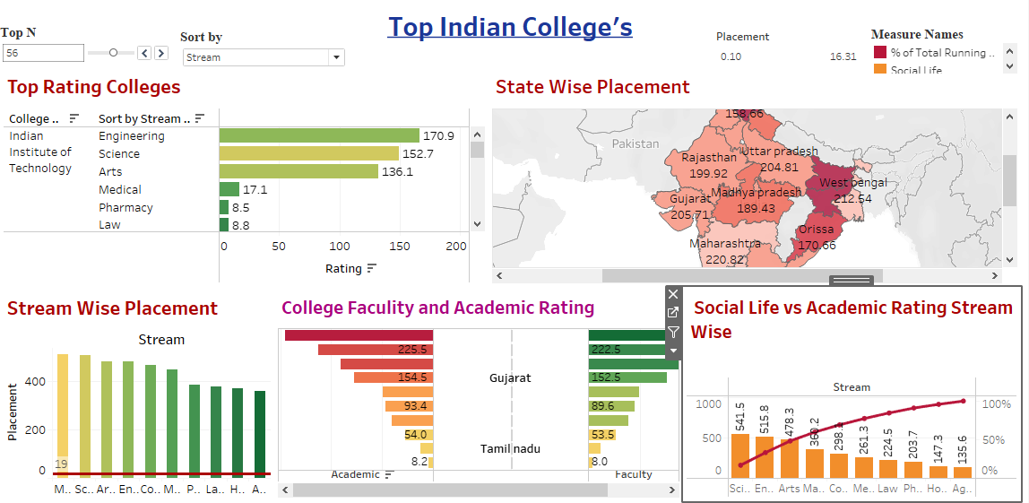
Final Dashboard

Slide 10
Conclusion
Tamil Nadu is the Top State having more Placements of IIT college in all the streams.
Management and Engineering Stream is most popular field in IIT and IIM colleges for students for there future scope.
IIT,NIT,IIM,Punjab University,Amity University Noida,BIT are the Top rating Colleges across the India.
Punjab,West Bengal,Uttar Pradesh,Kerla,Karnataka having highest Academic and faculty Rating.
IIM in Karnataka and IIT in UP Having highest academic rating colleges across India.

Slide 11
Project Link
https://public.tableau.com/app/profile/shrutika.gardas/viz/TopIndianColleges

Slide 12
THANK YOU..!!!

